Slide 1
2DFP (2D building footprint) extraction using aerial lidar point cloud
- Sona (22D1591), Apurva (22D1592), Sarvesh (22D1593), Sandhya (213040056) & Deekshant (22D1595)

Slide 2
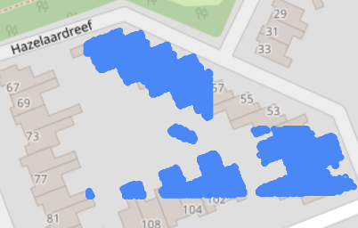
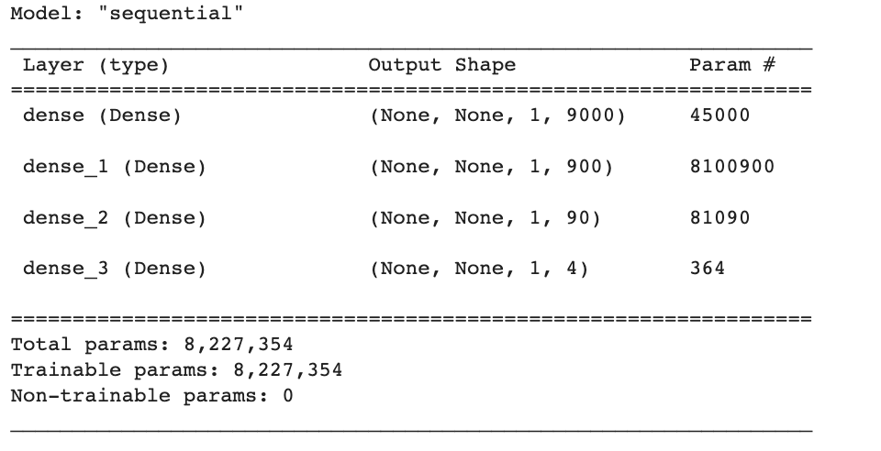
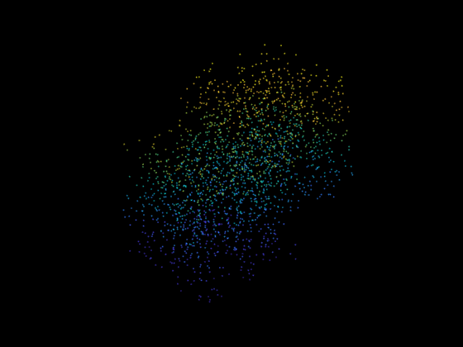
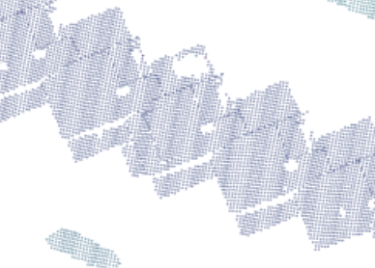
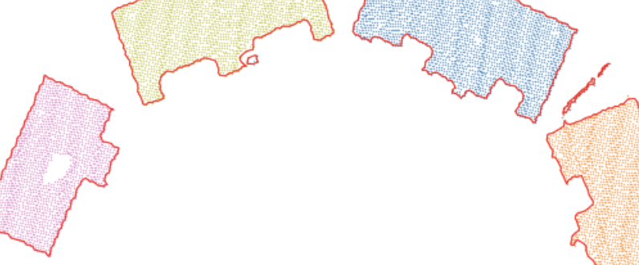
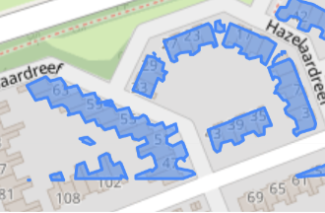
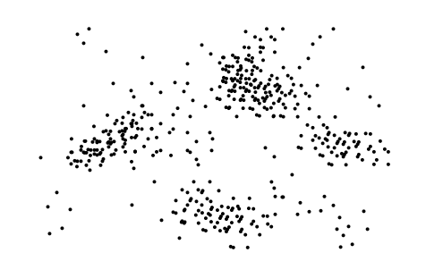
Architecture
Raw Lidar point cloud visualization on map
Raw Lidar point cloud
Convex Hull / Alpha Shape - Polygon creation
K Means/DBSCAN clustering
Classifier
Building class extraction
Reference mapping to open street map
(ANN,SVC,GNB, RF)
GAN
Discriminator
Latent variable
Point generation
Generator
Noise
Final building 2D footprint extraction & visualization
Supplement point cloud

Slide 3
List of Libraries
Open Lidar Data collection
Data preprocessing – Data correction, Projection system correction based on Netherland CRS, Exploratory data analysis
Open Libraries/APIs for satellite maps-
Open Street Maps
Libraries used:
GeoPandas
Pandas
Numpy
Torch
Geemap (map view)
Laspy (lidar points)
Rasterio
Kepler GL (interactive map)
Sklearn (SVC, GNB, RF, DT)
Keras
DBSCAN
Alpha Shape
torch

Slide 4
ML Experiments Performed
Experiment 1:Classification on lidar points into 4 classes (building is one the class) using Classifier:
1.1 ANN(Neural Network)
1.2 SVC (Support Vector Classifier)
1.3 DT (Decision Tree)
1.4 GNB (Gaussian Naive Bayes)
1.5 RF (Random Forest)
Experiment 2: Used GAN for generating more number of lidar points for same area to increase smoothness of building footprints.
Experiment 3: Used Exploratory data analysis (EDA) on Lidar data
3.1 Correlation Matrix
3.2 t-SNE
Experiment 4: Used K-Means and DBSCAN for clustering of lidar points and segregating points to create building shapes.
Experiment 5: Used Convex Hull and Alpha Shape for clustering of lidar points and segregating points to create building shapes.
Experiment 6: Different visualization using different maps.

Slide 5
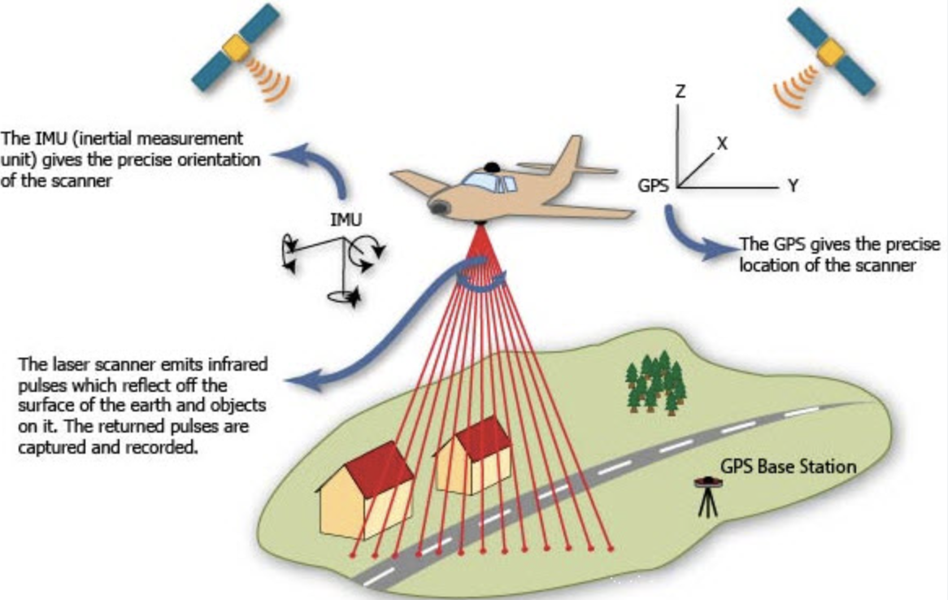
Quick overview of Lidar (Light Detection and Ranging)
Dataset:
Latitude
Longitude
Intensity
Elevation
Datapoints: 1826741 lidar points
Geography : Netherlands
CRS(Coordinate Reference System): EPSG:28992
https://www.elprocus.com/lidar-light-detection-and-ranging-working-application/

Slide 6
EDA (Exploratory Data Analysis)

Slide 7
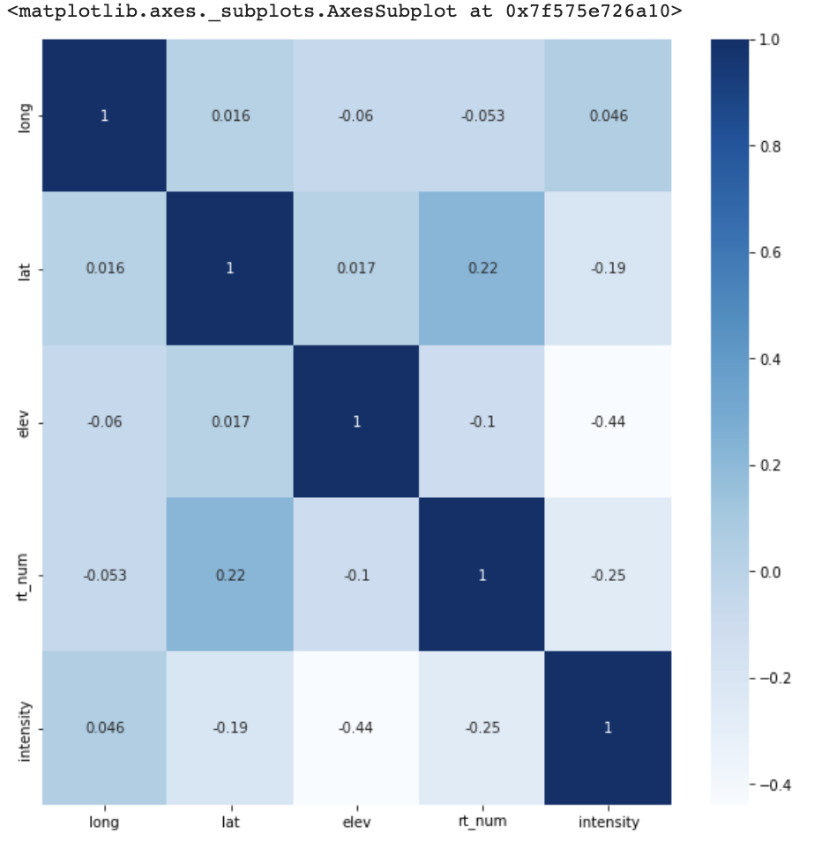
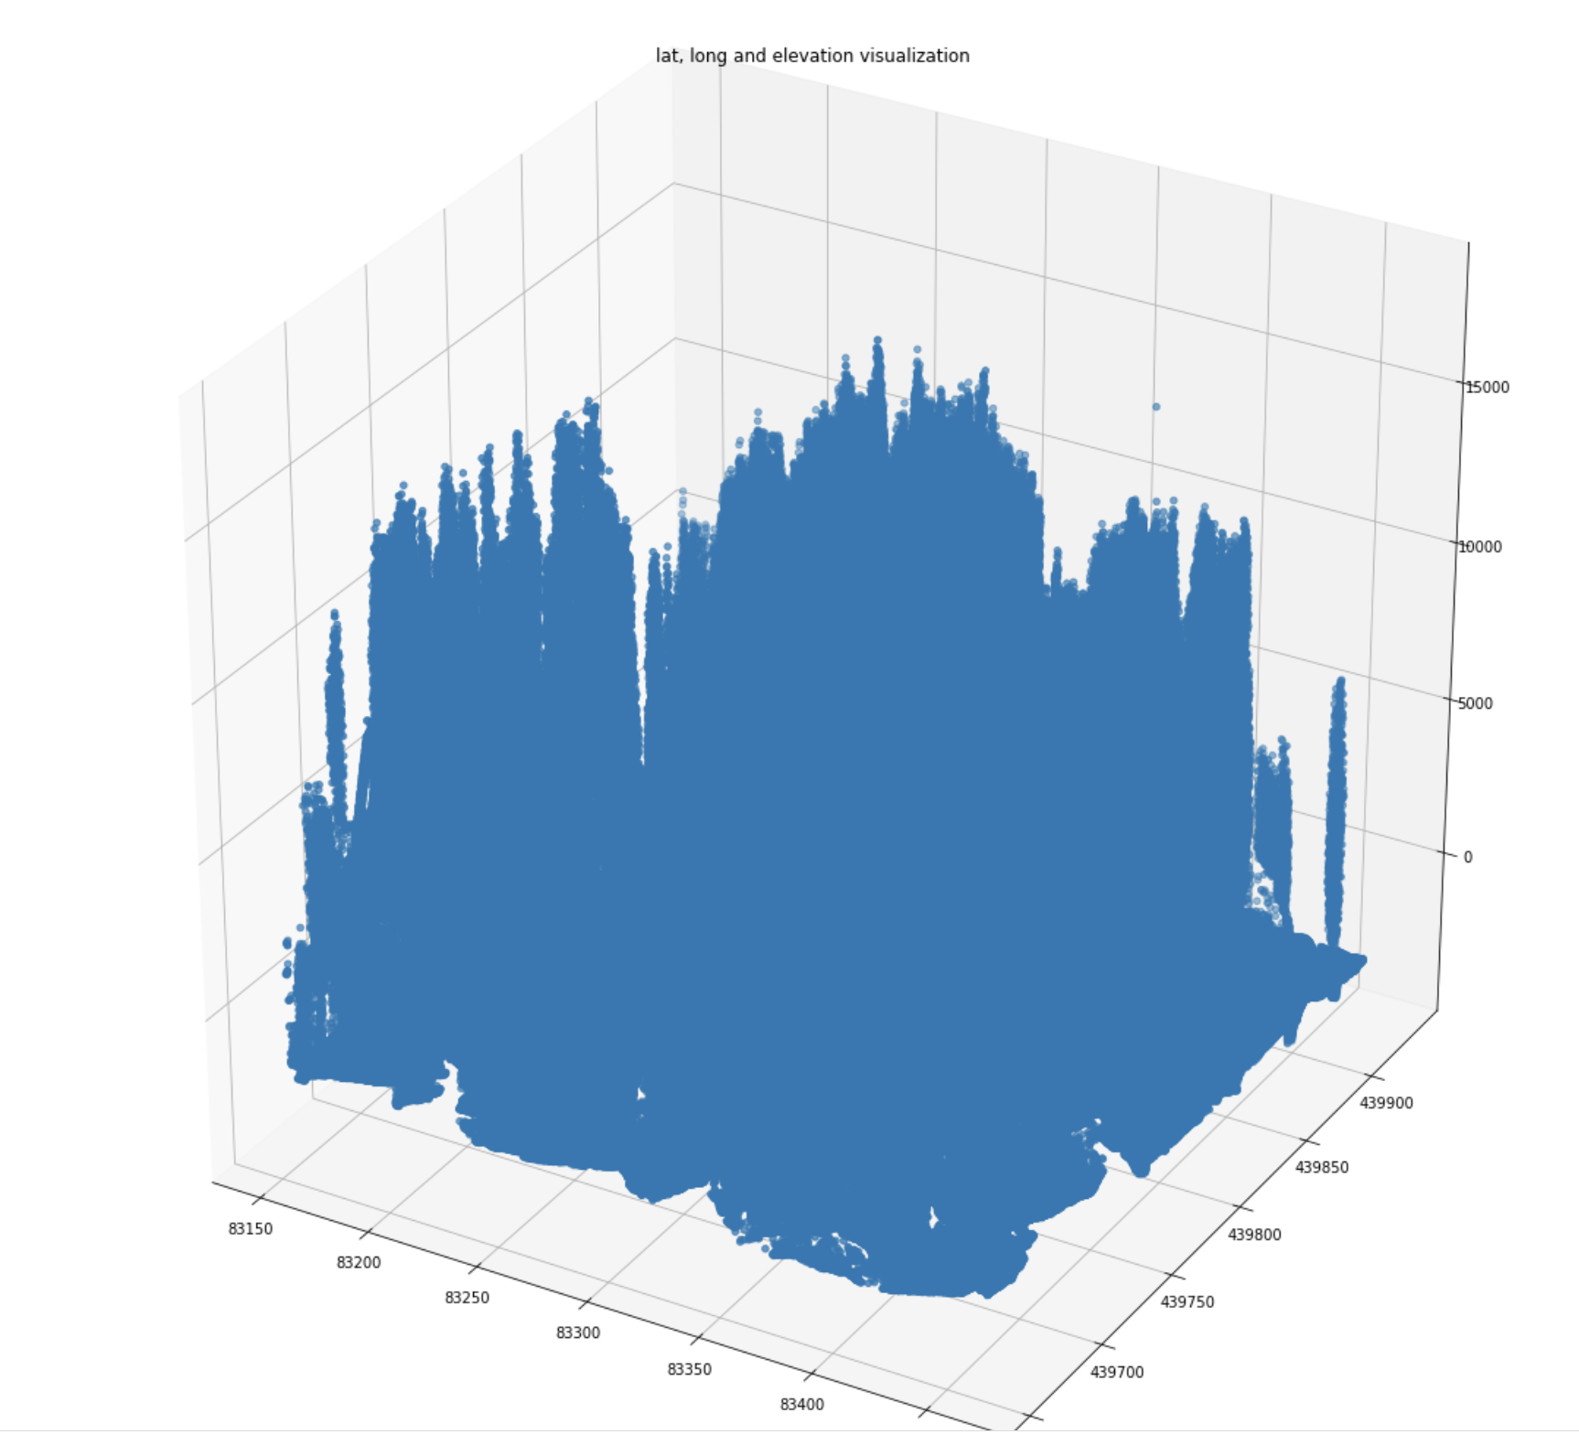
Correlation matrix of parameters
3D point plot of elevation,latitude and longitude
Key Takeaways:
Features are not much dependent (linearly) on each other

Slide 8
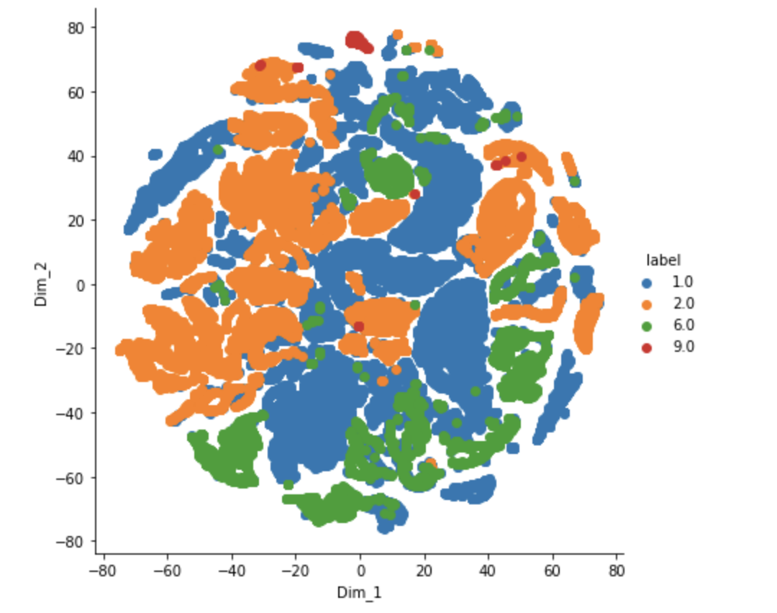
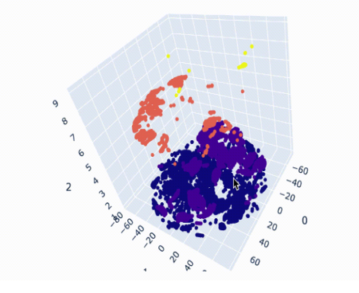
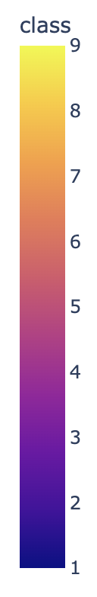
t-SNE (Distributed Stochastic Neighbor Embedding )
A 3D view of t-SNE to visualize different dimensions

Slide 9
Classifier

Slide 10
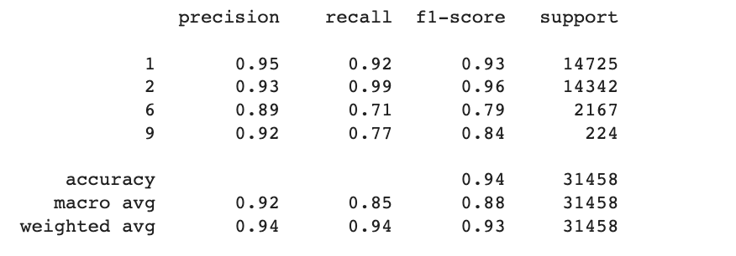
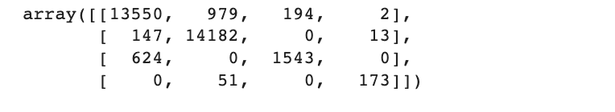
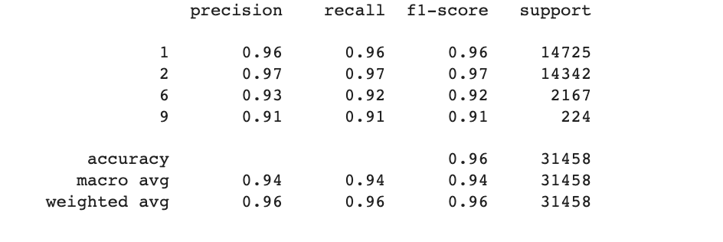
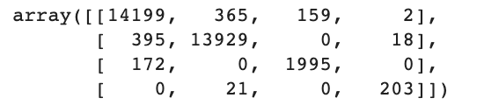
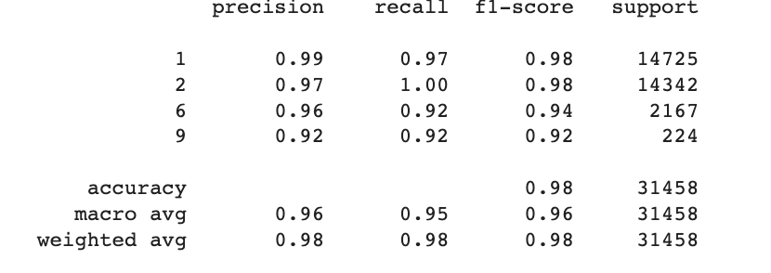
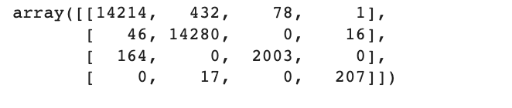
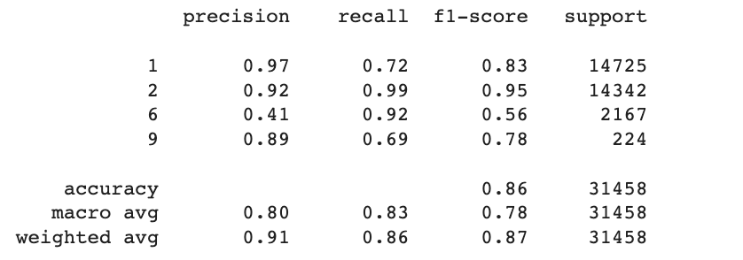
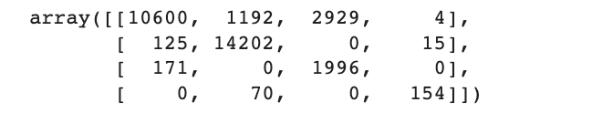
Support Vector Classifier
Decision Tree Classifier
Random Forest Classifier
Gaussian NB

Slide 11
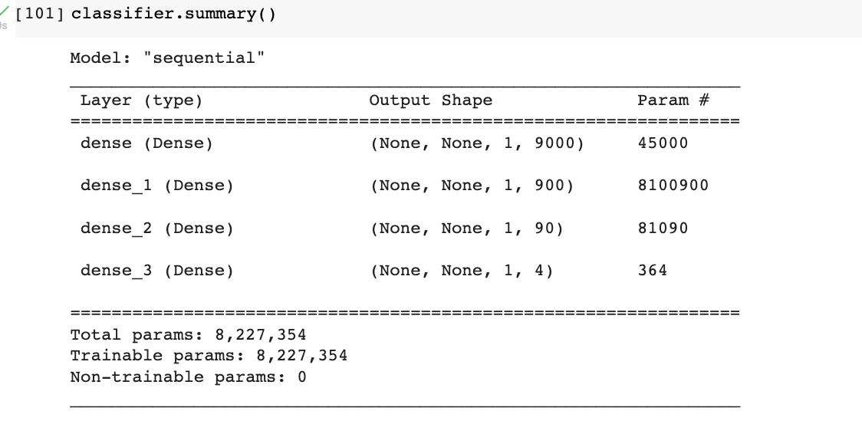
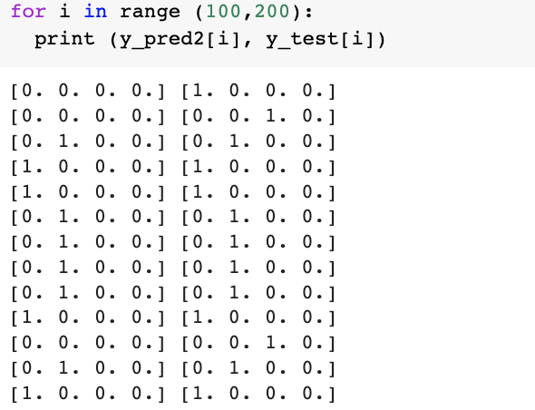
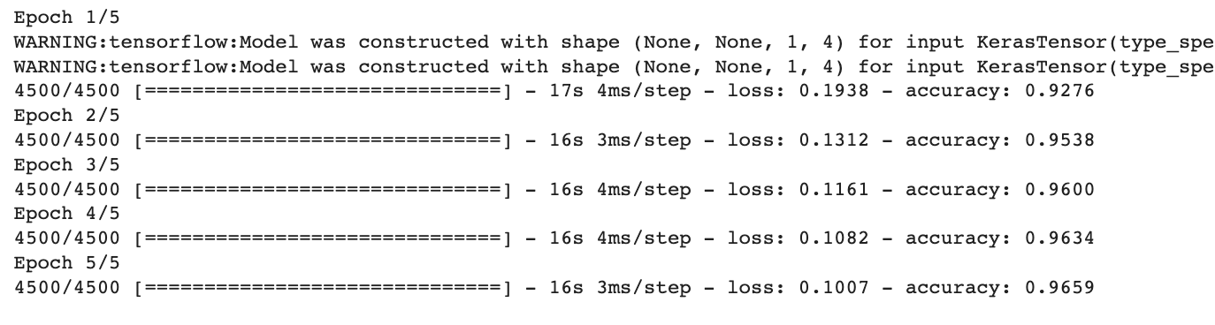
Model Summary
Output generated (Predicted v/s test)
Model training

Slide 12
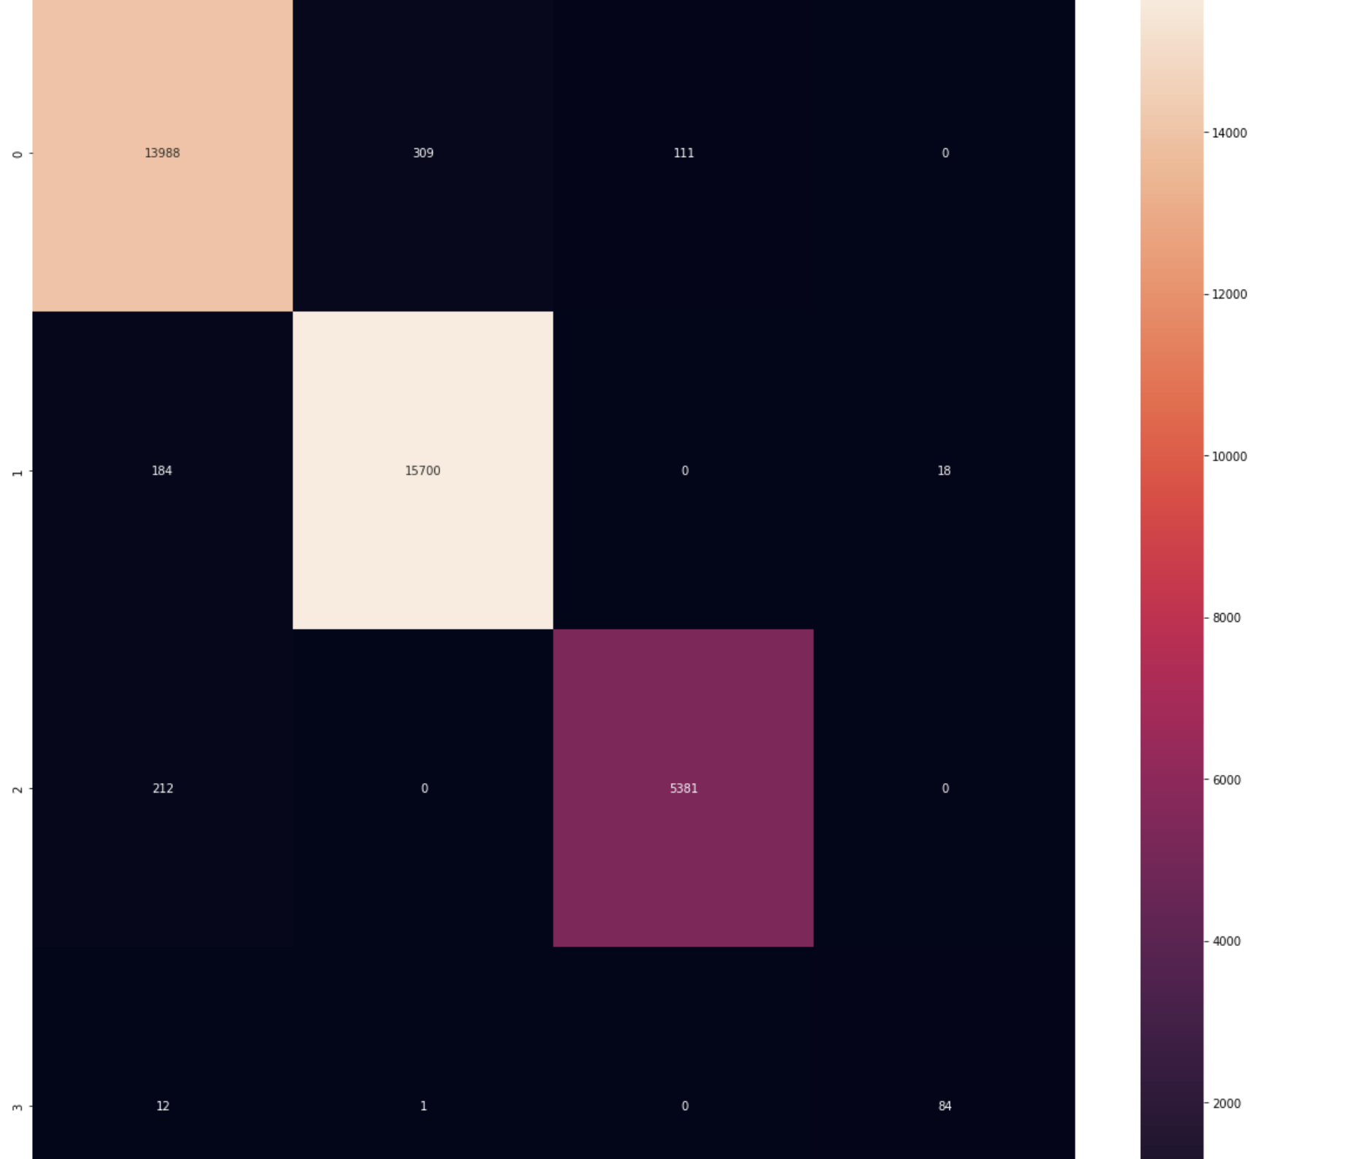
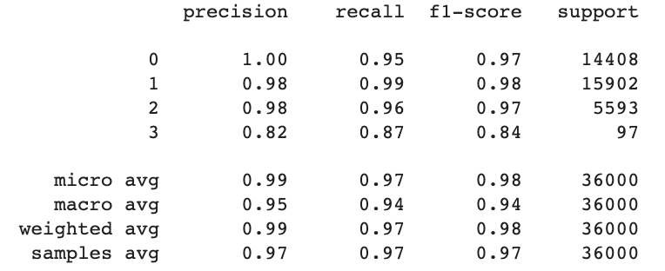
ANN output to extract class of building (represented as class 2 (pink) below) with accuracy of ~96.59% in 5 epochs
Note: Due to compute constraints and change in seed, number of testing examples in case of NN are different than that of ML models
Confusion Matrix
Classification Report

Slide 13
Summary of different networks that were run to create a classification model to extract building class :
Models |  | F1-Score
 | Accuracy | Class=1 | Class=2 | Class=6 (Building) | Class=9
ANN | 98% | 0.97 | 0.98 | 0.97 | 0.84
SVC | 94% | 0.93 | 0.96 | 0.79 | 0.84
Decision Tree | 96% | 0.96 | 0.97 | 0.92 | 0.91
Random Forest | 98% | 0.98 | 0.98 | 0.94 | 0.92
Gaussian NB | 86% | 0.83 | 0.95 | 0.56 | 0.78
Key Takeaways:
Random Forest and NN are giving highest accuracy.
F1 score for building class is highest for Class 6 which is the desired class. Hence, we move forward with ANN.

Slide 14
GAN Implementation

Slide 15
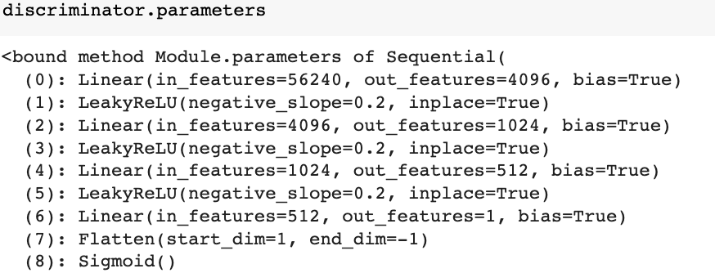
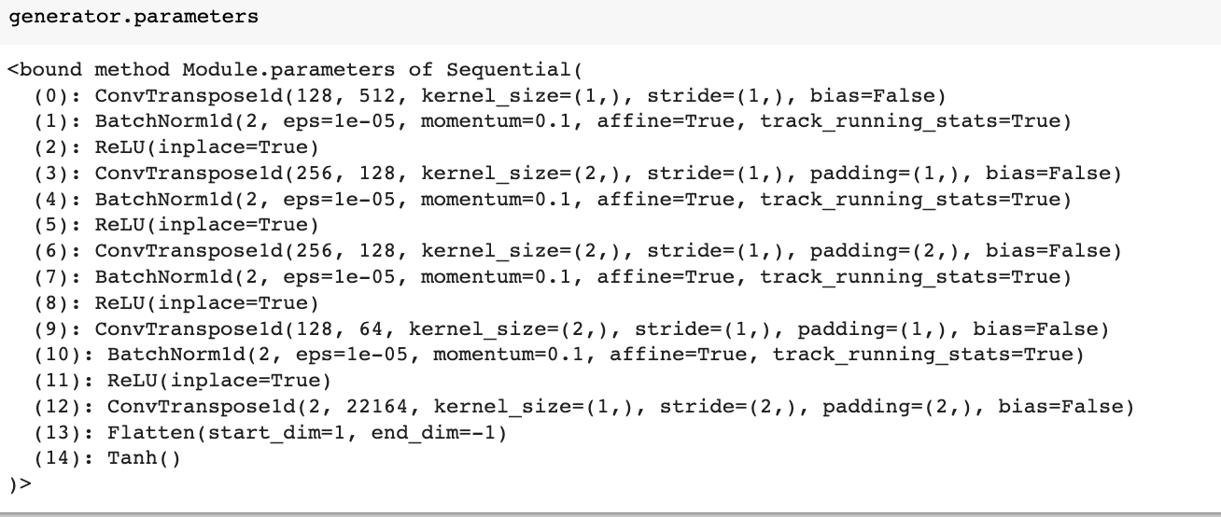
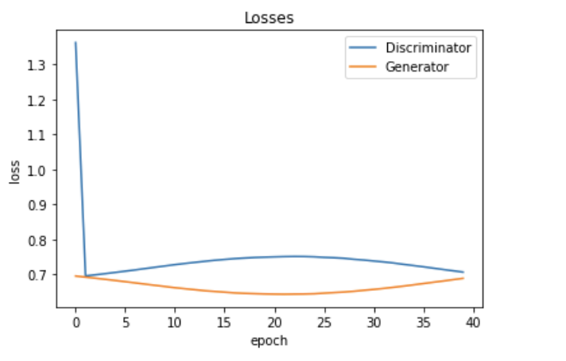
Discriminator v/s generator model summary
Take away: GAN experiment has not been very useful in creating value by adding artificial points

Slide 16
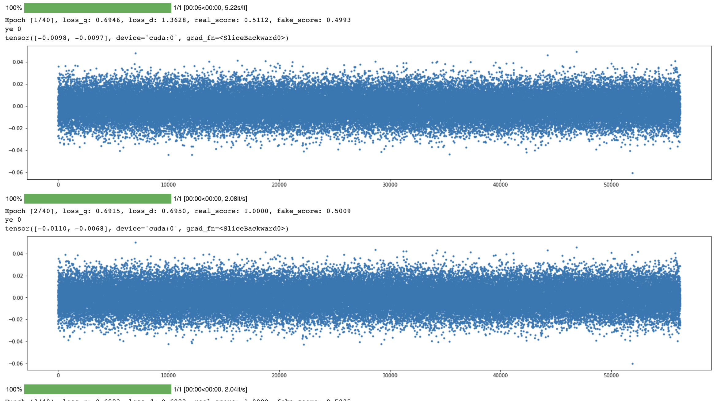

Slide 17
Implementation (Raw point Visualization)

Slide 18
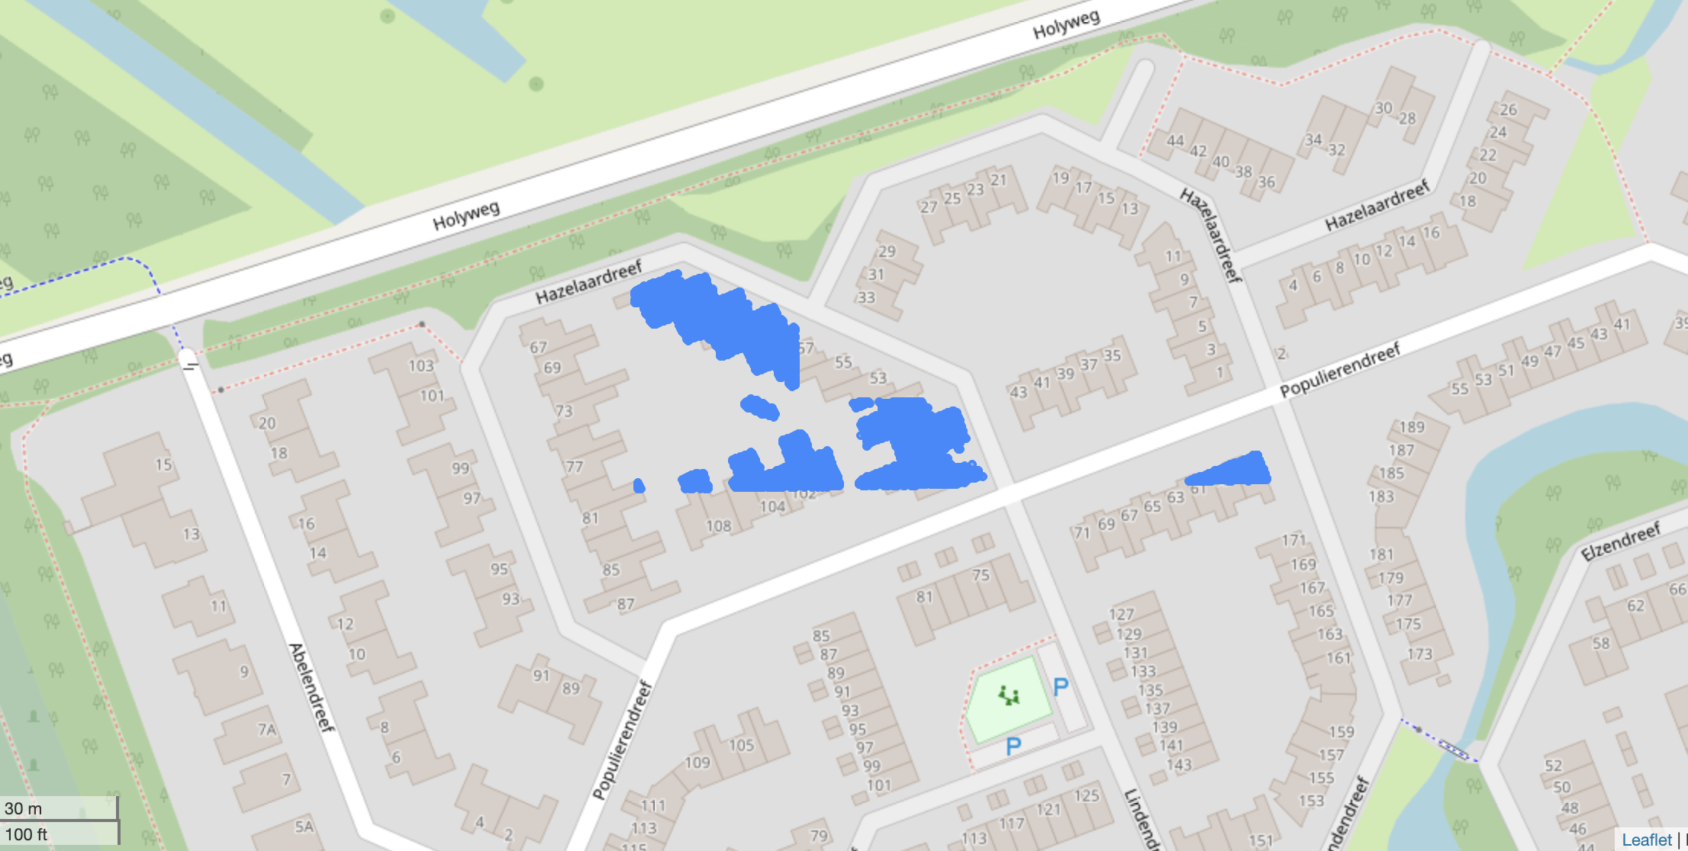
Visualization of building footprint using Folio (raw lidar points)

Slide 19
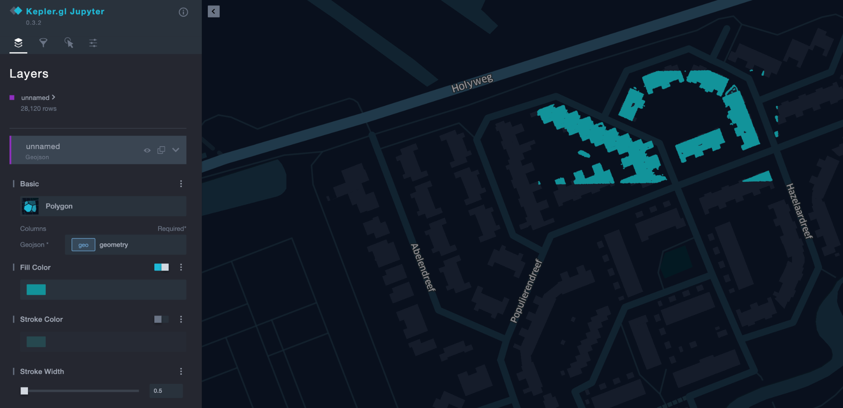
Interactive visualization of building footprint using Kepler GL (raw lidar points)

Slide 20
Clustering Lidar Points

Slide 21
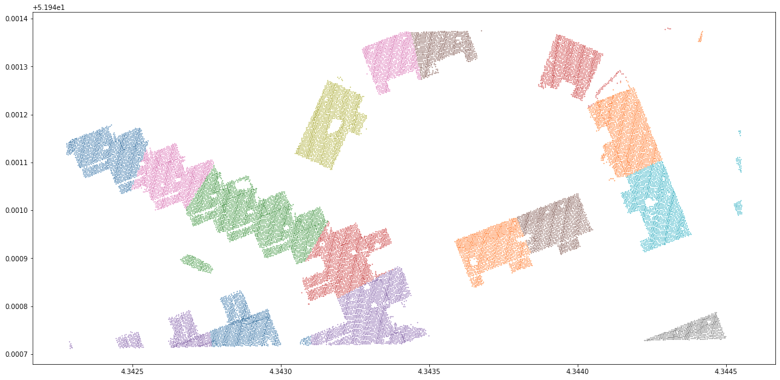
K-Means
K-means is a centroid-based clustering algorithm , where each cluster is associated with a centroid.
Number of clusters k needs to be fed as a parameter
Key takeaway : This isn’t suitable when data points are high density areas.
Experimentation result using K-Means
k = 18

Slide 22

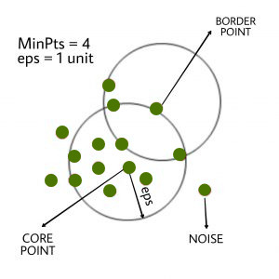
DBSCAN
The density-based clustering method connects the highly-dense areas into clusters, and the arbitrarily shaped distributions are formed as long as the dense region can be connected.
Source : https://www.youtube.com/watch?v=h53WMIImUuc
Source of image: Geeks for geeks (DBSCAN algorithm for representation purposes)

Slide 23
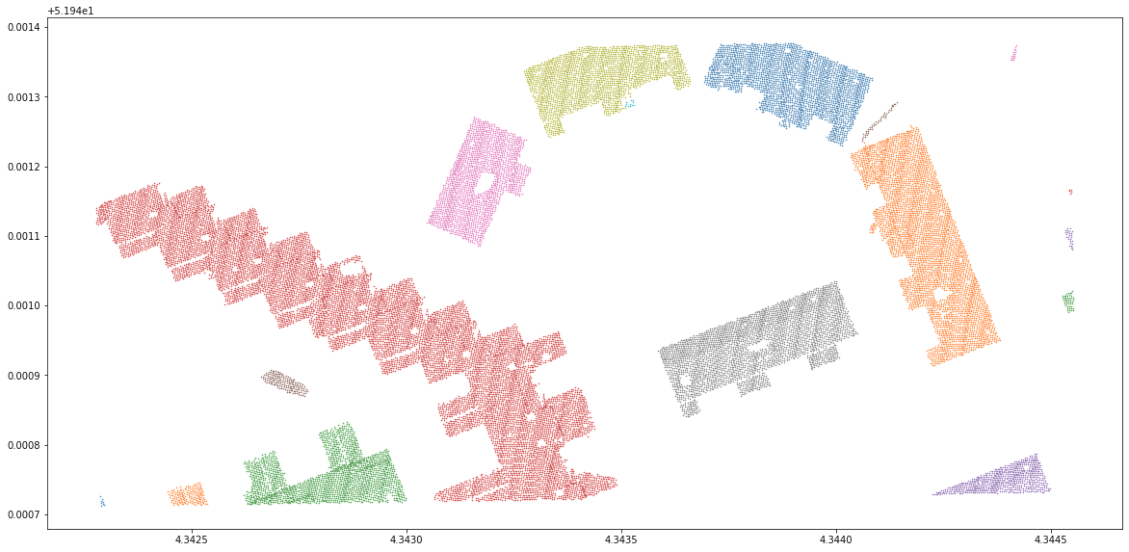
DBSCAN Implementation
Experiment result using DBSCAN
Eps value = 0.5 ; MinPts = 4

Slide 24
Building Footprint Extraction

Slide 25
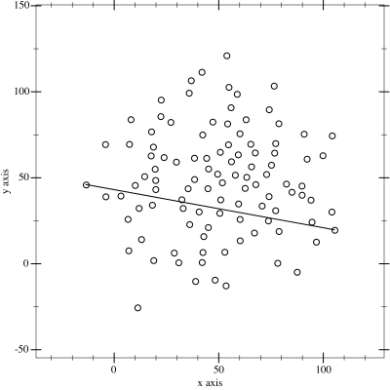
Convex Hull
Convex Hull using QuickHull Algorithm
Given a set of points in the plane, the convex hull of the set is the smallest convex polygon that contains all the points of it.
Source: https://en.wikipedia.org/wiki/Quickhull

Slide 26
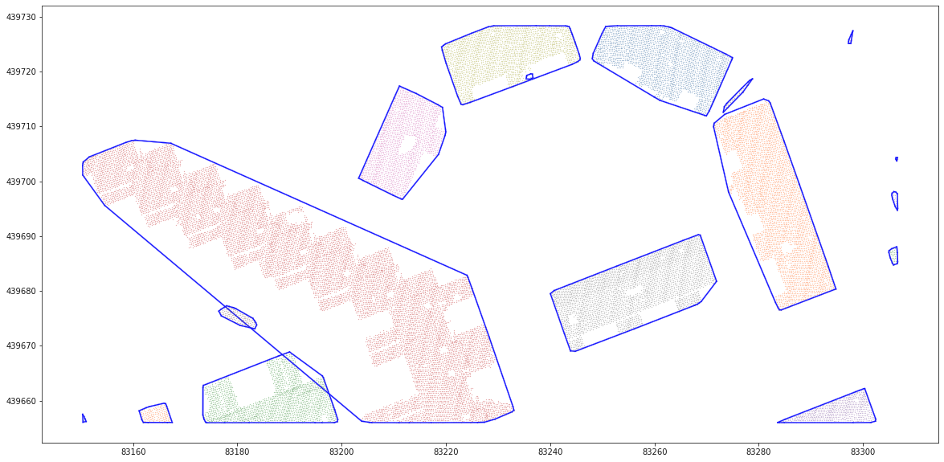
Convex Hull Results
Boundary using using Convex Hull

Slide 27
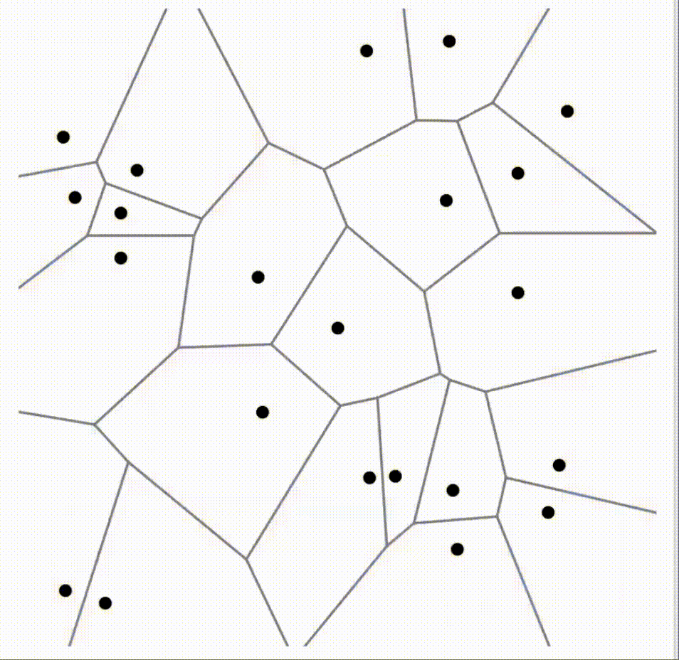
Alpha Shape
Alpha Complex Structure
Alpha shapes are used to generalize bounding polygons containing a set of points. The alpha algorithm is defined using an alpha parameter (α).
Disks of radius 1/α is drawn for the given set of points. Only those edges or triangles of the Delaunay triangulation whose disks meet each other are considered to form alpha complexes.
The alpha shape gives convex hull when α = 0.
In our project, we use α = 2.
Source: https://www.youtube.com/watch?v=-XCVn73p3xs

Slide 28
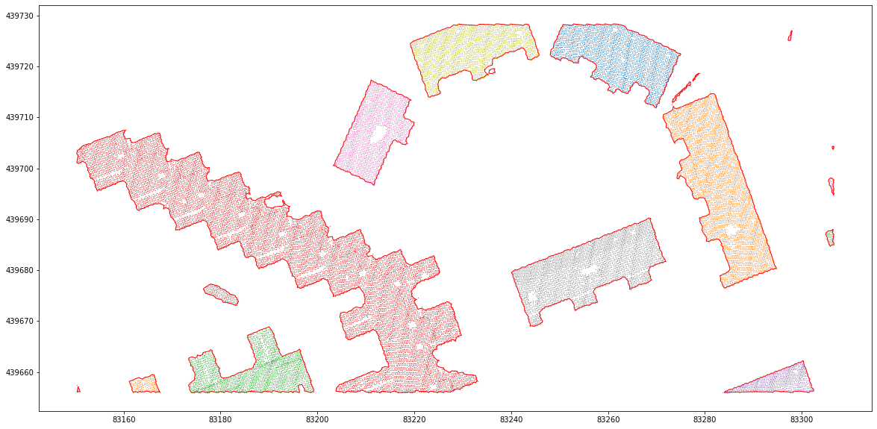
Alpha Shape Results
Boundary using Alpha shape

Slide 29
Evaluation Metrics

Slide 30
Other commonly used evaluation metrics :
Due to the absence of reference data, we have analyzed the building footprints visually using human intuition.
Evaluated against the ground- truth data based on pixel-based image classification metrics like correctness (precision), completeness(recall), accuracy, F1-Score, IoU score, etc.
Evaluated against the ground- truth data based on object-based image classification metrics like perimeter ratio and area ratio.
Count-based metric methods that quantifies the commission and omission errors in the number of buildings identified.

Slide 31
Final visualization of 2D footprint of Buildings

Slide 32
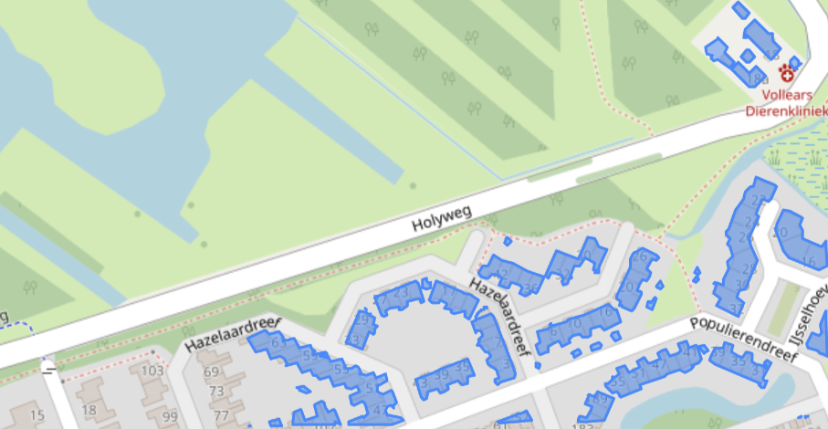
Visualization
https://github.com/DeekshantKumar/CS725---project
Please refer Github repository for source code

Slide 33
Team Contribution :
1. Deekshant (22D1595) : LiDAR data pre-processing, EDA
2. Sarvesh (22D1593) : Classification
3. Apurva (22D1592) : K Means, DBSCAN
4. Sona (22D1591) : Convex Hull, Alpha Shape
5. Sandhya (213040056) : Visualization

Slide 34
Thank You

